Slide 1
Threads & Concurrency Lesson 4

Slide 2
What Is a Thread?
A thread is the basic unit of CPU utilization. It represents the smallest sequence of programmed instructions that the operating system can schedule.
Every thread contains:
Thread ID – a unique identifier.
Program Counter (PC) – the address of the next instruction to execute.
Register Set – processor registers used during execution.
Stack – stores function calls, local variables, and control information.

Slide 3
What Is a Thread?
Unlike a full process, a thread shares several resources with other threads in the same process:
The code section (the program instructions).
The data section (global variables, heap memory).
System resources such as open files, signals, and sockets.
This sharing reduces overhead. Creating or switching between threads is much cheaper than doing so between processes.

Slide 4
Thread vs Child Process
1. What is a Child Process?
A child process is a separate process created by another process (the parent). It has:
Its own memory space
Its own code and data copies
Its own resources (files, registers, etc.)
Its own address space
The child does not automatically share variables, memory, or resources with the parent—unless special interprocess communication (IPC) is used.

Slide 5
Thread vs Child Process
2. What is a Thread?
A thread is the smallest unit of CPU work inside a process. All threads in a process:
Share the same memory (global variables, heap)
Share the same files
Share the same code
Only have their own stack, registers, and program counter
You can think of threads as “mini-programs” inside one parent process.

Slide 6
Thread vs Child Process
Simple Example
A web browser window has many threads:
One for rendering the page
One for downloading data
One for running JavaScript
They share the browser’s memory and files.

Slide 7
Introduction to Multithreaded Systems
Modern operating systems no longer treat a process as a single, indivisible thread of execution. Instead, a process can contain multiple threads, each representing an independent flow of control.
This shift has become essential due to the widespread use of multicore processors. With multiple CPU cores available, systems can perform multiple operations simultaneously, and threads are the mechanism that allows a single process to exploit this hardware parallelism effectively.
Traditional operating systems assumed every process executed one instruction stream at a time. However, with increasing complexity in applications—such as web browsers, productivity tools, and media processing—applications now need to perform several tasks concurrently. This need expanded the role of threads from a convenience to a fundamental execution structure

Slide 8
Single-Threaded vs. Multithreaded Processes
In a single-threaded process, the program has only one path of execution. If this thread becomes blocked, for example, waiting for user input, the entire process stops.
A multithreaded process, on the other hand, can have multiple execution flows. This means:
One thread can wait for input
Another can perform calculations
Another can respond to user actions All at the same time.
This structure makes applications more responsive and efficient.

Slide 9
Motivation for Multithreading
1 Increasing Use of Multicore Architectures
Modern CPUs contain multiple cores capable of true parallel execution. To benefit from this, software must perform multiple operations at once. Threads allow an application to divide its work into tasks that run concurrently on different cores. Without threading, an application might use only a fraction of the available processing power
2 Improved Application Responsiveness
User interfaces require immediate feedback. If long-running operations were done on the main thread, applications would freeze or become unresponsive. By assigning heavy tasks to background threads, applications remain smooth and interactive.

Slide 10
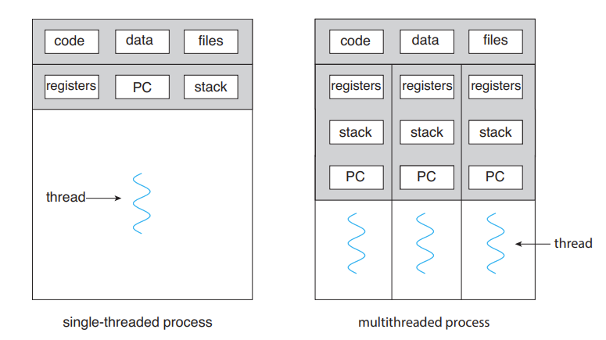
Diagrammatic representation

Slide 11
Real-World Examples of Multithreaded Applications
Example 1: Web Browser
A modern web browser performs many tasks simultaneously, such as:
Rendering text and images
Downloading web content
Running JavaScript
Managing multiple open tabs
Each of these tasks can run in separate threads so that a delay in one (such as downloading large files) does not freeze the entire browser.

Slide 12
Real-World Examples of Multithreaded Applications
Example 3: Word Processor
A word processor must look simple, yet internally it handles many tasks:
One thread manages user input (keyboard and mouse)
Another thread handles spell-checking in the background
A third thread updates document layout and graphics
Additional threads may monitor autosave or file synchronization
This design keeps the application responsive even when processing large documents.

Slide 13
Benefits of Multithreading
1. Responsiveness
Applications remain usable even when performing long operations because other threads continue running.
2. Resource Sharing
Threads share code and data within the same process. This reduces memory use and improves efficiency compared to running multiple processes.
3. Economical
Creating and switching between threads uses far fewer resources than doing the same with full processes.
4. Scalability
Threads allow programs to take advantage of multicore CPUs by distributing work across cores. For example, a CPU with 8 cores can run 8 computation threads in parallel, leading to significant speed improvements.

Slide 14
Challenges of Multithreading
While multithreading offers many advantages, it also introduces complexity:
1. Synchronization Problems
Because multiple threads share the same memory, they can accidentally interfere with each other. For example:
Two threads updating the same variable can cause inconsistent results.
Race conditions occur when the output depends on unpredictable ordering of thread execution.
2. Difficult Debugging
A bug that depends on thread timing may be hard to reproduce, making multithreaded applications more complex to test and debug.

Slide 15
Challenges of Multithreading
3. Deadlocks
Two or more threads may wait forever for each other’s resources, causing the entire program to stall.
4. Context Switching Overhead
Although lighter than processes, switching between threads still has cost.

Slide 16
Multicore Programming
A multicore processor contains two or more independent processing units called cores, each capable of executing its own thread. To the operating system, each core behaves like a separate CPU. Because of this design, multicore processors allow true parallel execution—multiple operations happening at the same time.
To take full advantage of multicore systems, software must be designed to perform multiple tasks concurrently, and this is achieved using multithreaded programming. A single-threaded program wastes the potential of multicore hardware because only one core can execute its instructions at a time. A multithreaded program, by contrast, can distribute work across several cores and finish tasks significantly faster.

Slide 17
Concurrency vs Parallelism
A crucial distinction for us to understand is the difference between concurrency and parallelism, because the two concepts are related but not identical.
Concurrency
A system is concurrent if more than one task can make progress, even if not at exactly the same time. On a single-core CPU, the processor runs only one thread at a time, but switches rapidly between threads. To the user, it appears as though tasks are progressing together, even though they are not literally running simultaneously.

Slide 18
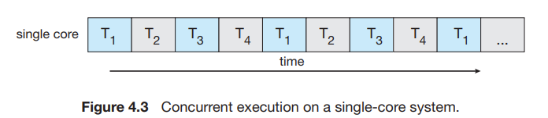
Concurrency vs Parallelism
Example: On a single-core laptop, you may type in a document while music plays. The CPU switches very quickly between:
Handling keyboard input
Decoding audio
Updating the screen
This rapid switching creates the illusion of many tasks running at once

Slide 19
Concurrency vs Parallelism
Parallelism
Parallelism means multiple tasks are literally running at the same time on different cores. This requires a multicore or multiprocessor system.
Example: With four cores, a computer can run:
Thread A on core 1
Thread B on core 2
Thread C on core 3
Thread D on core 4
These tasks genuinely occur simultaneously—not interleaved.

Slide 20
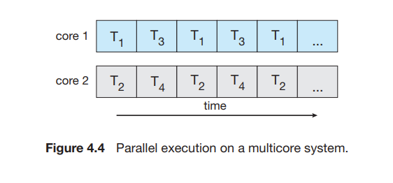
Concurrency vs Parallelism

Slide 21
Concurrency vs Parallelism
Important Insight
All parallel execution implies concurrency.
But concurrency does not require parallelism. Before multicore processors existed, all systems used concurrency without parallelism by relying on fast context switching. Thus, it is possible to have concurrency without parallelism.

Slide 22
Why Multicore Programming Matters
As computers with 4, 8, 16, or even 64 cores become common, programmers must redesign software to divide work into multiple parts.
If a program remains single-threaded:
It will use only one core
The rest of the CPU cores become idle
Performance gains are wasted
Therefore, both operating-system designers and application developers face the challenge of creating truly parallel software.

Slide 23
Programming Challenges in Multicore Systems
Programming for multicore systems is not as simple as “just add threads.” There are five major challenges, each of which requires careful thought.
1. Identifying Tasks
The first challenge is determining which parts of a program can be broken into independent tasks. Each task should be something that can run separately without needing constant information from other tasks.
Example: In a video processing program, you might separate tasks into:
Decoding video frames
Applying filters
Encoding output frames
However, not all tasks can be separated. Some algorithms are inherently sequential, meaning one step depends heavily on the result of the previous step.

Slide 24
Programming Challenges in Multicore Systems
2. Balancing the Workload
Once tasks are identified, they must be balanced so that each task performs roughly equal work. If tasks are uneven, some cores will finish early and sit idle while others continue working.
This is known as load balancing.

Slide 25
Programming Challenges in Multicore Systems
3. Splitting Data Across Cores
Just as work must be divided into tasks, the data they operate on must be divided as well.
For efficient parallel execution:
Threads must work on separate portions of data
Without interfering with each other
Without needing constant synchronization

Slide 26
Programming Challenges in Multicore Systems
4. Managing Data Dependencies
Sometimes one task depends on data produced by another task. This creates a data dependency, which limits how much parallelism is possible.
Programmers must ensure:
Correct execution order
Safe access to shared data
Synchronization where necessary
If not handled carefully, issues like race conditions, inconsistent data, or deadlocks can occur.

Slide 27
Programming Challenges in Multicore Systems
5. Testing and Debugging Parallel Programs
Parallel programs are much harder to test because:
Execution order changes each time the program runs
Bugs may appear only under rare timing conditions
Two threads might interfere only occasionally
This unpredictability makes debugging extremely challenging.

Slide 28
THANK YOU

